Slide 1
Braeden Helgren

Slide 2
Introduction
Planning to go to UViC to study computer science.
Wanting to work in the programing industry, whether that would be video games, or other types of software.
For the presentation I have made a video game.

Slide 3
Learned
How to manage big projects Multiple source files Separate tasks by importance Keep everything organized
What goes into game development Player control Collision system Enemy AI

Slide 4
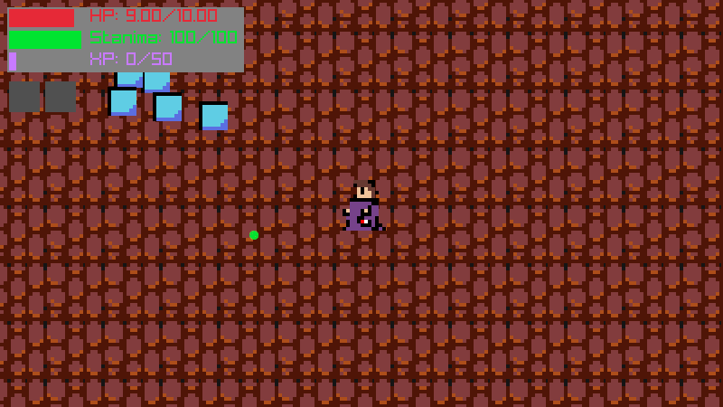
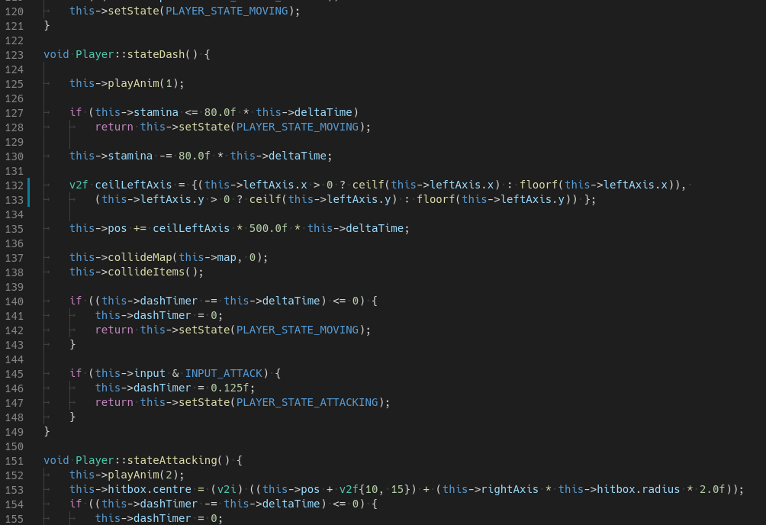
The game
Dungeon crawler
~3000 lines of code
Written in C++ with Raylib

